Slide 1
Multimedia Communication over distributed systems
Premchand Lingamgunta
Goutham Gandreddi

Slide 2
Abstract
Distributed Multimedia Systems is an area of active commercialization and research. This technology is widely viewed as the next generation technology for computers and communication networks. This paper will discuss some features of the technology, its architecture, and scalability. Also we will see some of the current trends in this technology.

Slide 3
OVERVIEW
Introduction
Architecture
2.1 User Terminal
2.2 Network and Communication
2.3 Multimedia Server
2.3.1 Requirements for Multimedia Server
Comparative Analysis of protocols.
Current Trends In DMS
Conclusion

Slide 4
Introduction
Research and development efforts in multimedia falls in two groups. One group concentrates on the stand-alone multimedia workstations and associated software and tools. The other combines multimedia with the distributed systems.
The distributed multimedia system offers a broader spectrum of implementation possibilities in comparison to stand - alone systems. But in addition to the possibilities they all add a new dimension to the system complexity.

Slide 5
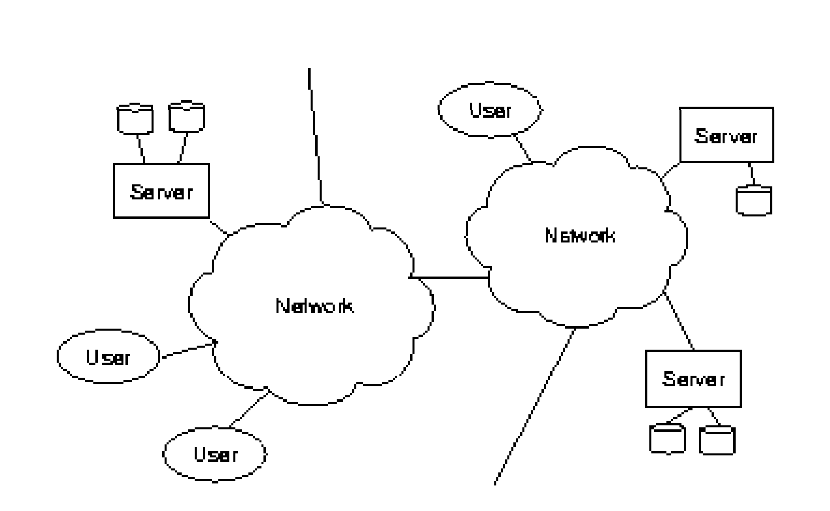
Architecture
We know present an architecture for the distributed multimedia systems and set the stage for presentation of integration and technology issues in the next section. The architecture is presented at the level of abstraction suitable for the content of the paper.

Slide 6
2.1 User Terminal
The user interacts with the system via a computer keyboard, mouse or a hand held remote control. Many of the user terminals still resemble traditional computers.

Slide 7
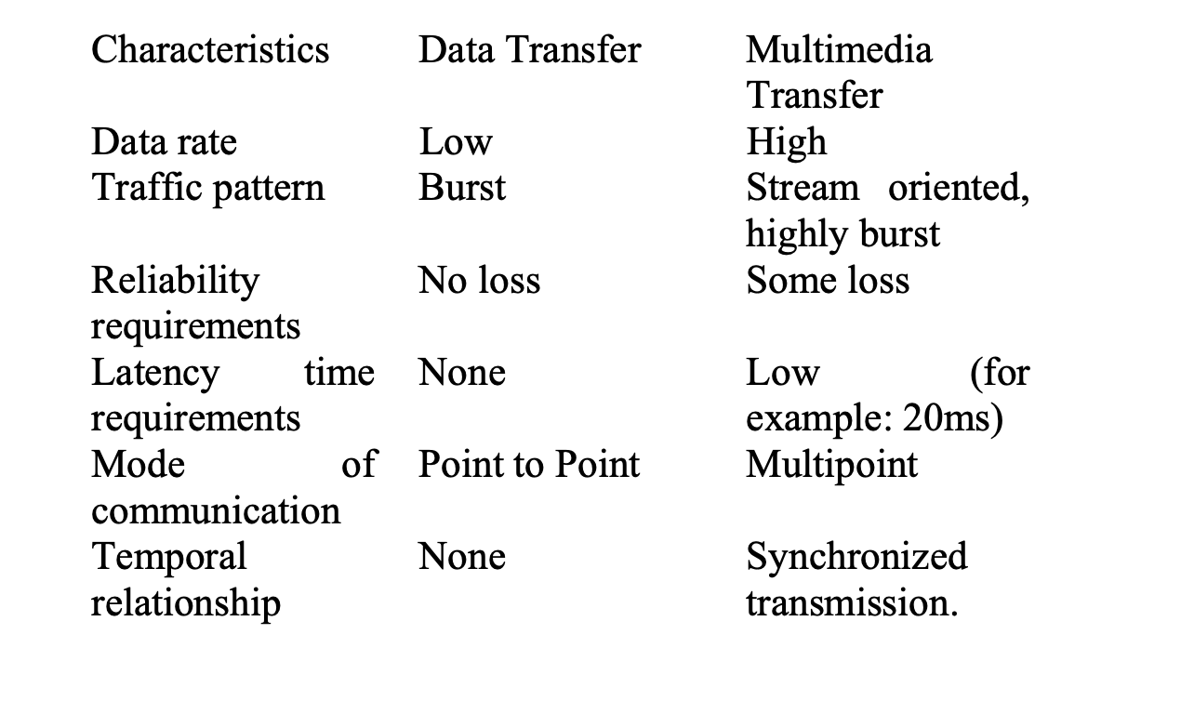
2.2 Network and Communication
Multimedia communication differs from the traditional communication. The multimedia traffic requires transfer of large volumes of data at very high speeds, even when the data is compressed.

Slide 8
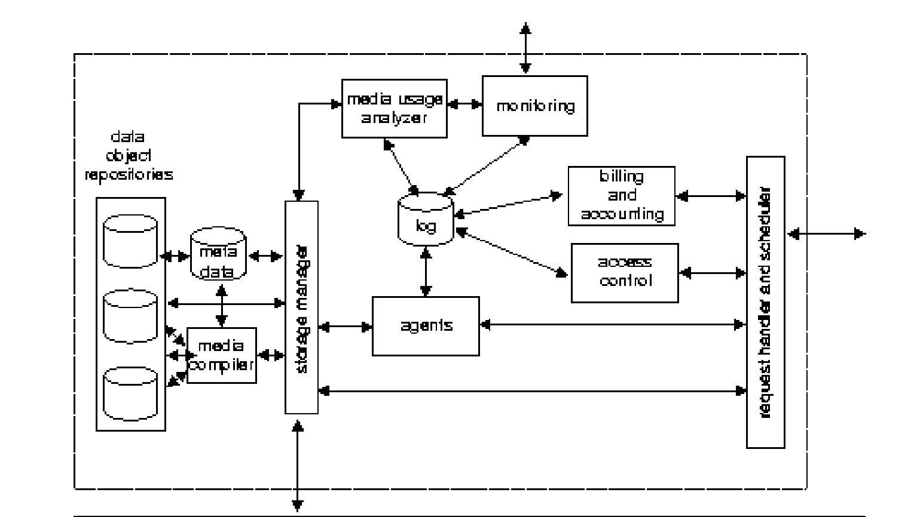
2.3 Multimedia Server
Components of a multimedia Server
The scheduler and request handler takes care of the I/O data flow of the server. It handles the requests and manages the data flow to and from the server.
to restrict the access only to certain users or network domains, the server must include access control.
Since many planned systems will include commercial services a billing and accounting module must be present.
The server requires administration and supervision. For this all transactions are logged in a log repository and a monitoring tool is provided.
The storage manager manages the data in the object repositories and the data flow.
To be able to manage the data effectively and to be able to offer personalized services, the system should also include agents

Slide 9
2.3.1 Requirements for Multimedia Server are:
Minimal Response time
Fast Processing Capability
Reliability and availability:
Ability to sustain guaranteed number of streams
Real-time delivery
High storage capacity
Quality of Service (Qos) requirements
Exploit user access patterns
Ability to handle different types of traffic
Cost effectiveness

Slide 10
Comparative Analysis
Real Time transport protocol (RTP) is an end-to-end transport protocol. It used to support multimedia traffic on Internet
The functionality of RTCP
Quality of Service
Inter-media synchronization
Identification RTF’ data packets
Real-time Transport Protocol key management mechanisms is adequate, the complexity of SRTP based on Datagram Transport Layer Security (DTLS) is too high to reduce the scope of use, using DTLS to achieve key management and negotiating encryption algorithms
The Real Time Streaming Protocol (RTSP) is a network control protocol designed for use in entertainment and communications systems to control streaming media servers The protocol is used for establishing and controlling media sessions between end points

Slide 11
Real-Time Messaging Protocol (RTMP) was initially a proprietary protocol developed by Macromedia for streaming audio, video and data over the Internet, between a Flash player and a server
RTMPE which is RTMP encrypted using Adobe's own security mechanism. While the details of the implementation are proprietary, the mechanism uses industry standard cryptographic primitives.
RTMP is encapsulated within HTTP requests to traverse firewalls. RTMPT is frequently found utilizing cleartext requests on TCP ports 80 and 443 to bypass most corporate traffic filtering. The encapsulated session may carry plain RTMP, RTMPS, or RTMPE packets within

Slide 12
 | Transportation Protocol | Server Interaction | StateFullness | quality-of-service | resource reservation |  | Time reconstruction | Loss Detection | Security | Content Identification | Multicast | Unicast | Broadcast | VOD | Internet-telephony
RTP | UDP | One way ( Server -> Client ) | N | does not guarentee | N | Asymmetic | Y | Y | Y | Y | Y (Primarily built for) | Compatible |  | Y | Y
SRTP | UDP | One way ( Server -> Client ) | N | Y | N | Asymmetic | Y | Y | SRTP uses encryption and authentication to minimize the risk of denial of service( DoS ) attacks | Y | Y | Y | N | Y | Y
RTCP | UDP | NA | NA | provides feed back on Qos to RTP | provides feed back on Qos to RTP | NA | provides feed back on Qos to RTP | provides feed back on Qos to RTP | N | provides feed back on Qos to RTP | N | N | N | N | N
RTCPS | UDP | NA | NA | provides feed back on Qos to RTP | provides feed back on Qos to RTP | NA | provides feed back on Qos to RTP | provides feed back on Qos to RTP | Y | provides feed back on Qos to RTP | N | N | N | N | N
RTSP | Typically, RTSP uses TCP as its transport protocol,RTSP can also use UDP | Two way communication possible | Y | Y |  | Symmetric | Y |  | Y |  | Y | Y |  | Y | N
HTTP |  | One way ( client -> server) | N |  | N | Asymmetic | Y |  | Y |  | Y | Y |  | N | N
RSVP | IP as its transport protocol | One way ( client -> server) | Y | has special packets to request the customised Qos based on the individial customer | Y | Asymmetic | N |  | Y |  | reciever must establish a connection with multicast group | Y | N | Y | Y
RTMP | TCP | two way communication possible | Y | Y | Y | Asymmetic | Y |  | Y | Y | Y | Y |  | Y
RTMPS | TCP | two way communication possible | y | y | y | Asymmetic | y |  | RTMPS is Real-Time Messaging Protocol over an SSL/TLS network | y | y | y |  | Y
RTMPT | TCP | two way communication possible | y | y | y | Asymmetic | y |  | tunneled version of RTMP designed to get around strict corporate firewalls by sending stream packets through the standard web port (port 80) wrapped in http packets | y | y | y |  | Y
RTMPE | TCP | two way communication possible | y | y | y | Asymmetic | y |  | (E stands for encrypted) is essentially the same as RTMP except that it adds a layer of security by encrypting stream packets before transmission. | y | y | y |  | Y
RTMPTE | TCP | two way communication possible | y | y | y | Asymmetic | y |  | tunneled version of RTMPE designed to get around strict corporate firewalls. | y | y | y |  | Y
RTMFP | UDP | two way communication possible | y | y | y | Asymmetic | y |  |  | y | y | y |  | Y

Slide 13
Video on Demand News and Reference Services Interactive shopping and electronic commerce Entertainment and games Distance Learning
Current Trends in DMS

